Slide 1
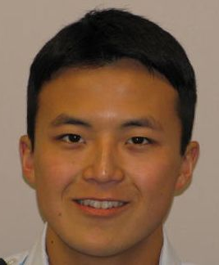
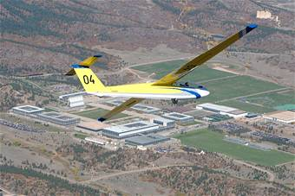
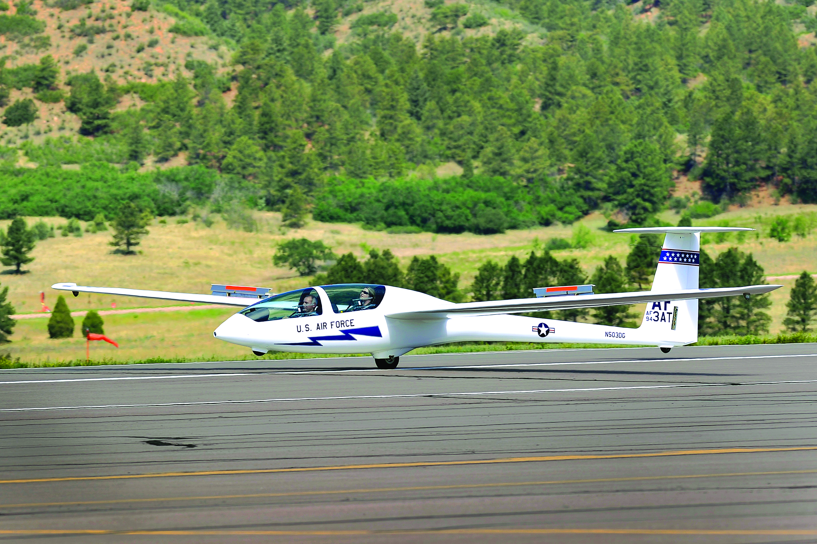
Sabin Park
Air Force Academy Senior
Computer Engineering major
Glider Instructor Pilot
Mentor: Jeff McLamb

Slide 2
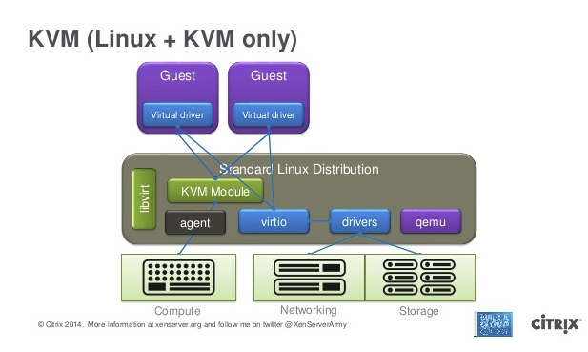

Sabin Park
Learning x86 architectural details ahead of OS coursework next semester
Introduction to exploitation via exploit-exercises.com and Hacking: The Art of Exploitation
Get familiar with QEMU/KVM architecture
Write a plugin to QEMU (custom QMP) for use on the FROSTBITE project

